Slide 1

MMA 823 Analytics for Financial Markets
Instructor: Mehmet Beceren, Ph.D.
SESSION 2: Debt Financing, Rates, and Credit Risk
Master of Management Analytics 2025

Slide 2
Today’s Agenda
Recap of CAPM, APT, Factors
Project/Assignment discussions
Debt Instruments, Bond Pricing
Rates, Yield Curves
Credit Ratings
Project discussions again

Slide 3
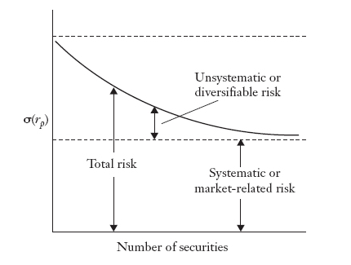
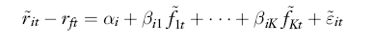
Arbitrage Pricing Theory (APT) Recap
Intermediate layer that may managed or diversified
Common Factor Risk
Under CAPM, all the (possible) risk factors sum up to a Macro Risk that cannot be diversified away. The “Market Portfolio” reflects the optimal outcome of the aggregate behaviour of risk averse investors.

Slide 4
Factors in Practice
The APT does not provide any specific information about what the factors are, nor does it make any claim regarding the number of factors. (In contrast, the CAPM claims a single factor and that factor is the market.)
The APT simply assumes that the returns are driven by the factors (another tautology?), and if the smart investors know the betas (via learning or estimating), then an arbitrage portfolio, which requires no investment but yields a positive return, can be formed if the APT-pricing relation is violated in the market.
In equilibrium if there are no arbitrage opportunities, we should not observe deviations from the APT-pricing relation.
Mainly Three Types of Factor Models in Practice
1. Macroeconomic factor model (Macro/Systematic Factors, external to assets)
Factors are observable economic and financial time series
2. Fundamental factor model (Driven by measured asset characteristics)
Factors are created from observable asset characteristics
3. Statistical factor model (Estimated from asset’s data, not measured)
Factors are unobservable and extracted from asset returns
They are made-up statistics such as technical indicators
Or, latent variables that inferred from data
Then, the differences in asset returns must be driven by the market participants that are seeking arbitrage opportunities originating from factor exposures.
What could those factors be?
Are there any prevalent and persistent factors that can be identified?

Slide 5
Machine Learning in Finance: Fit for purpose?
It is an ongoing discussion… but limitations are obvious
Noisy, chaotic nature of the data makes it difficult to model data patterns that are persistent and explainable

Slide 6
To find your way in the factor zoo is hard
Establish an Ex Ante Economic Foundation
Do Not Arbitrarily Exclude Outliers
Beware an Ex Post Economic Foundation
Keep Track of What Is Tried
Ensure Data Quality
Document Choices in Data Transformations
Recognize That Iterated Out of Sample
Is Not Out of Sample
Seek Interpretable Machine Learning
https://www.youtube.com/watch?v=_KXyr4l6AG4&t=599s
Minute 10+

Slide 7
Factor Zoo and Back-testing
“Computing power is cheap, data source is ample and it is easy to perform millions of back tests and find which one works best or looks best to clients.”
“The worst ten-year period for any back-test is the next ten years.”
https://www.youtube.com/watch?v=BtiqH_7d2es&t=564s
minutes 4-8,

Slide 8
Predicting returns (the future) with ML is much harder than image recognition
In short, the more you try to fit a good looking performance or predictive power to your data sample, the more likely you will make unreliable conclusions.
In general, that is true for all statistical & ML methods whether it is financial data or not.
In particular, the problem is bigger for financial returns data because ‘features’ are being fitted to a single history. That is why, deep-learning type methods are mainly not that fruitful to predict the future returns. They are all based on the same ‘target input’ (historical data or returns).
“While machine learning and AI are becoming more and more ubiquitous, investing is still a challenging area to apply such techniques, López de Prado says. Beating the collective wisdom of the crowds is much more difficult than recognizing faces or driving cars. “My dog can recognize faces,” he says. “My teenage daughter speaks three languages. I would not entrust my savings to either of them.”
Machine Learning: Separating the Signal From Noise in Investing, Bloomberg News, WERP Wealth Management, 2018-10-12
Marcos Lopez de Prado: Leading researcher, academic and quantitative finance expert with many books and articles
But there are success stories as well. There is value in data analysis when you figure the right (timely) modeling method and useful data.

Slide 9
Risk Factors, Hedge Funds, Quant Finance
These hedge funds seem to be able to capture value from market data
Note: Hedge Funds
Hedge funds attempt to identify investment opportunities with positive risk-adjusted returns. In most cases they attempt to generate returns that are uncorrelated with the market (zero beta). Hedge funds have much greater flexibility in terms of strategy and instruments compared to mutual funds. Therefore, hedge fund investors must meet the ‘sophisticated investor’ standards.
Investing in hedge funds is costly. They charge high fees and take part of the profits- depending on agreement.
Hedge funds have proprietary models and methods. Investors do not know the details of the positions, leverage levels etc. Redemptions are limited.
What are the common quant strategies?
What is a hedge fund, how does it work?
See the case document:
Hedge Funds and Portfolio Applications
What is a recent, dramatic story of hedge funds blowing up due to their short positions?
See: https://www.youtube.com/watch?v=ZzL5OLCwSPY&t=658s

Slide 10
Bonds, Rates, Yields: Corporate Finance Perspective
Corporate Debt vs. Equity (Recap)
Firms invest in new plant and equipment to generate additional revenues and income (or to sustain current production). Earnings (=profits) generated by the firm belong to the owners and can either be paid to them as dividends or retained within the firm. The owners’ investment in the company is referred to as owners’ equity or, simply, equity.
Decisions about how the firm’s investments should be financed, whether with debt or equity, are referred to as capital structure decisions.
Debt and equity financing create different types of obligations for the company. The concept of leverage plays a role in affecting the company's financial risk because leverage amplifies the effects of operational outcomes. The fixed and limited nature of a debt obligation affects the risk of the earnings available for distribution to the owners.

Slide 11
Debt vs. Equity Financing
Debt vs. Equity Financing Example
Suppose that the Matrix Corporation has $120 million of assets, all financed with equity, and that the firm has 6 million shares of stock outstanding valued at $20 per share. Suppose further that management has identified investment opportunities requiring $60 million of new funds and can raise the funds in one of the following three ways:
Financing package 1: Issue $60 million equity (3,000,000 shares of stock at $20 per share)
Financing package 2: Issue $30 million of equity (1,500,000 shares of stock at $20 per share) and borrow $30 million with an annual interest of 8%
Financing package 3: Borrow $60 million with an annual interest of 8%
Financing Package | Assets (million) | Debt | Equity | No. of shares (million) | Debt-to-equity ratio | Debt-to-assets ratio
1 | $180 | $0 | $180 | 9 | 0 | 0
2 | $180 | $30 | $150 | 7.5 | 20% | 16.7%
3 | $180 | $60 | $120 | 6 | 50% | 33.3%

Slide 12
Debt vs. Equity
Debt vs. Equity Financing Example
Financing Package | Assets (million) | Debt | Equity | No. of shares (million) | Debt-to-equity ratio | Debt-to-assets ratio
1 | $180 | $0 | $180 | 9 | 0 | 0
2 | $180 | $30 | $150 | 7.5 | 20% | 16.7%
3 | $180 | $60 | $120 | 6 | 50% | 33.3%
Suppose the Matrix Corporation has $27 million of operating earnings. What is the ROA? ROE?
Return on Assets
Return on Equity
Assuming there are no taxes, then the earnings per share for the three financing packages.
Financing Package | 1 | 2 | 3
Operating earnings in millions | $27.0 | $27.0 | $27.0
Interest expense in millions | $0 | $2.4 | $4.8
= Earnings available to owners in millions | $27.0 | $24.6 | $22.2
No. of shares in millions | 9 | 7.5 | 6
Earnings per share | $3.0 | $3.28 | $3.7

Slide 13
Leverage and Creditworthiness
The three financing packages based on assumptions for the return on assets.
Financing Package | 1 (least leverage) EPS | 2 EPS | 3 (most leverage) EPS
Assumed ROA
15% | $3.0 | $3.28 | $3.7
12% | $2.4 | $2.56 | $2.8
8% | $1.6 | $1.6 | $1.6
When company is leveraged the effect of ROA on EPS is magnified.
Earnings-per-Share can be boosted with leverage when returns are worthwhile / cost is low
When ROA is 8% in this example, the EPS is the same for the three packages, so the choice of financing is irrelevant for EPS. Return on additional assets is equal to cost of financing.
The greater the use of debt versus equity, the greater the operating risk.
When macroeconomic outlook worsens and expected return on investment (or current assets) declines, companies with high debt are expected face greater risk on EPS growth. That, in turn, affect creditworthiness and cost of financing. Equity valuations shrink (stock price declines, risk premium rises)

Slide 14
Cost of Debt vs. Equity Financing
Debt vs. Equity Financing Cost
A firm's cost of capital is the cost of its long-term sources of funds: debt, common stock, and preferred stock, if any. The cost reflects the risk of the assets in which the firm invests.
The cost of each source of funds reflects the hierarchy of the financial risk associated with its seniority over the other sources.
For a given firm, the cost of funds raised through debt is normally less than the cost of funds from preferred stock, which, in turn, is less than the cost of funds from common stock. This is because creditors have seniority over preferred shareholders, who have seniority over common shareholders.
If there are difficulties in meeting obligations, the creditors receive their promised interest and principal before the preferred shareholders, who, in turn, receive their promised dividends before the common shareholders.
Academically speaking
Estimating the cost of capital requires management to estimate the cost of each source of capital along with the amounts raised from each source.
Cost of debt is straightforward, but not cost of equity. (What happens when a company announces share issues to finance its obligations? )
??

Slide 15

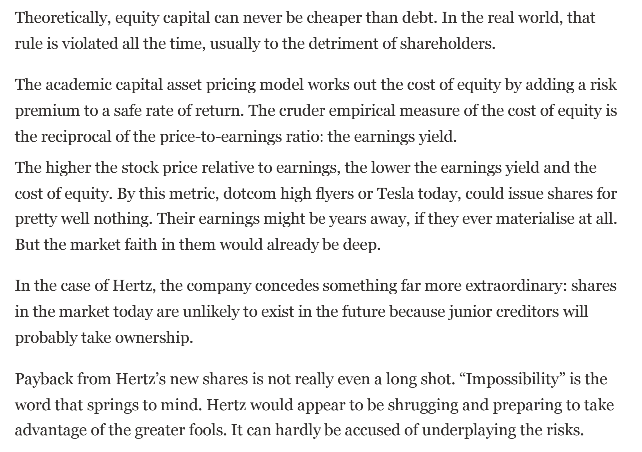
Academic logic does not necessarily apply all the time
Financial Times, 2020

Slide 16
Corporate Debt
Corporate Debt Instruments
Once the decision of how much debt to issue is determined, the next step is to determine what debt instrument should be issued. The alternatives for corporate management are corporate bonds, medium-term notes, commercial paper, bank loans, and asset-backed securities.
Corporate Bonds
Important Parameters:
Maturity (Date the bond is paid and retired)
Coupon Rate (Periodic payment rate)
Secured or Unsecured (Collateral to ensure payment or not)
Provisions (Callable)
Convertible or not (Convertible to common stock)
Duration

Slide 17
Corporate Debt (continued)
Medium Term Notes
Debt notes offered continuously to investors by an agent of the issuer. Investors can select from several maturity ranges: nine months to one year, more than one year to 18 months, more than 18 months to two years, and so on up to 30 years.
To fill the funding gap with flexibility offered by instruments with different maturities.
Asset-Backed Securities (ABS)
Pool of assets/cash-flows securitised --- long-term receivables are used for short term funding
Commercial Paper
Commercial paper is a short-term promissory note issued in the open market as an obligation of the issuing entity. The maturity of commercial paper is usually less than 270 days.
Used by larger corporations with strong credit ratings

Slide 18
Corporate Bank Loans
Bank Loans
Bank loans are an alternative to issuing securities. A corporation may use any of five sourcing alternatives: (1) a domestic bank in the corporation's home country; (2) a subsidiary of a foreign bank established in the corporation's home country; (3) a foreign bank domiciled in a country where the corporation does business; (4) a subsidiary of a domestic bank established in a country where the corporation does business; or (5) an offshore or Eurobank.
A bank loan is either an investment-grade loan or a leveraged loan. The former is a bank loan made to a corporate borrower that has an investment-grade rating.
A syndicated bank loan is one in which a syndicate of banks provides funds to a borrower. The need for a syndicate or group of banks arises because the amount sought by a borrower may be too large for any one bank to be exposed to the credit risk of that borrower. These bank loans are called senior bank loans because of their priority position over subordinated lenders (bondholders) with respect to repayment of interest and principal.

Slide 19
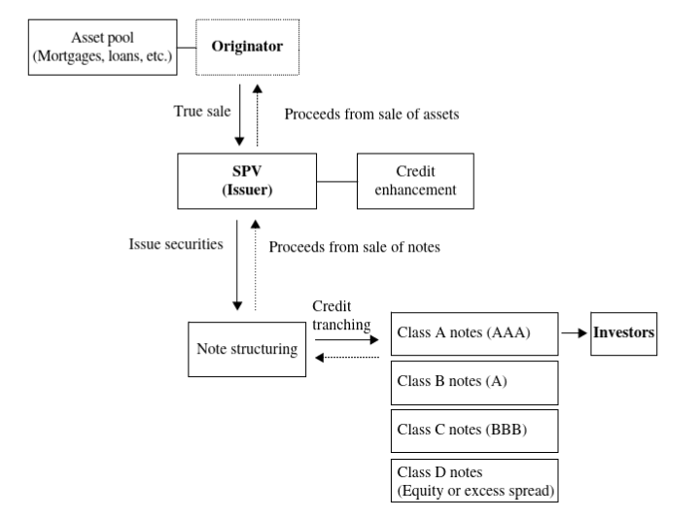
Asset-Backed Corporate Securities
Asset-Backed Securities (ABS) & Tradeable Tranches
Securitised / Collateralized / Structured Debt
Instruments
Synthetic versions of these ‘pooled’ debt instruments and speculation around those complex, leveraged structures drove the financial crisis in 2008.
The Big Short

Slide 20

Bond Pricing
Price reflects the present value of expected future cash flow
Reflects the risk adjustment
$$P=\frac{C}{{(1+r)}^{t1}}+\frac{C}{{(1+r)}^{t2}}+…\frac{F}{{(1+r)}^{T}}$$
F: Face value of the bond to be paid at maturity
C: Coupon payments
r: Discount rate or yield-to-maturity
Higher the risk, less the confidence in future payments, lower the price == higher the yield
If money demand is high and/ or money supply is low, time value is higher
+
If inflation is expected to be high , thus future purchasing power is lower
>> higher yield
But there is also the time value of money and inflation effect
Add the borrower’s risk of payment
Additional risk premium (credit spread)
Credit rating

Slide 21
Treasury Yield Curve
September 2022 Data
Taxation and money printing authority of government makes government debt low(er) risk (generally).
Treasury curve (and inter-bank swap curve) serves as a benchmark for time value and inflation adjustment part of the bond discount rate (yield).
It is a benchmark of the cost of lending for banks/lending institutions.
Yield Curve captures the yields available for government bonds across different maturity dates. An upward sloping yield curve suggests longer-term bond yields may continue to rise, reflecting expectations of economic expansion. Conversely, an inverted yield curve suggests yields on longer-term bonds may fall, reflecting expectations of economic recession.
See https://ig.ft.com/the-yield-curve-explained/

Slide 22
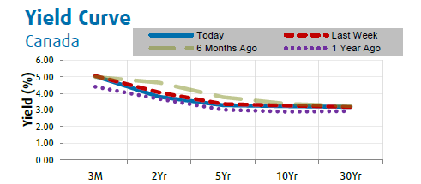
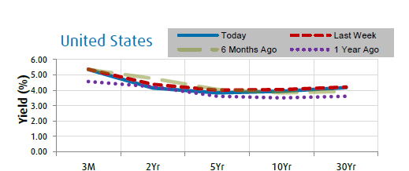
Treasury Yield Curve
January 2024 Data
Yield Curve captures the yields available for government bonds across different maturity dates. An upward sloping yield curve suggests longer-term bond yields may continue to rise, reflecting expectations of economic expansion. Conversely, an inverted yield curve suggests yields on longer-term bonds may fall, reflecting expectations of economic recession.
See https://ig.ft.com/the-yield-curve-explained/

Slide 23
What determines the shape of the yield curve?
See the case:
Yield Curve and Growth Forecasts
Case discussion

Slide 24
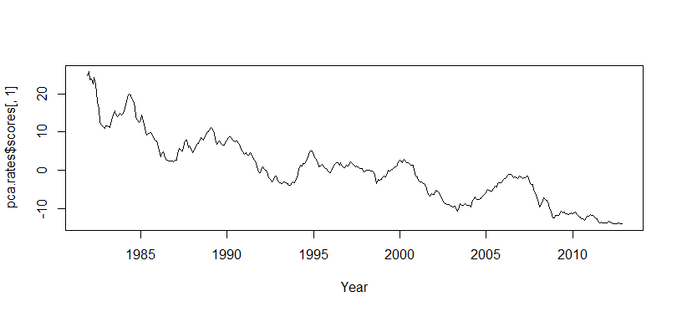
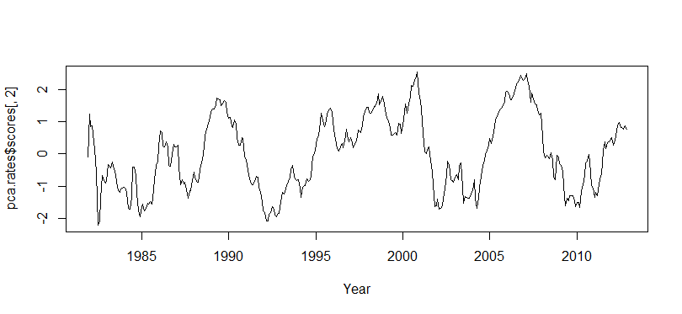
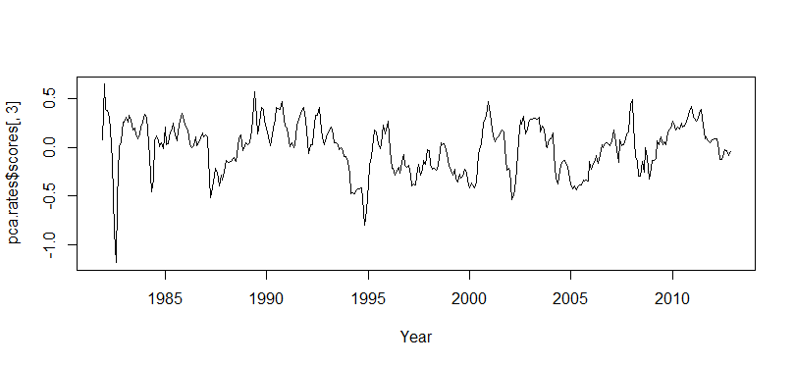
Components of the Yield Curve
PCA example in R
Nelson-Siegel Method
See the code example on D2L

Slide 25
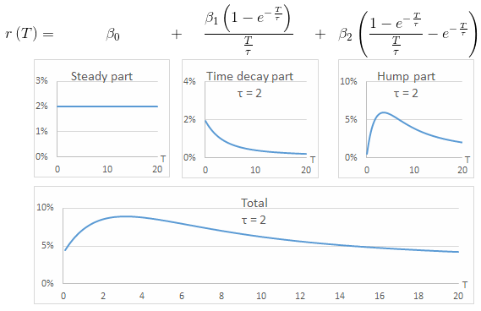
Components of the Yield Curve
Curve fitting models
Nelson-Siegel Method
Nelson-Siegel Method

Slide 26
Credit Spreads
September 2022
Spread: In addition to the treasury curve
Corporate Yield = Treasury yield + spread
Higher spread, higher credit risk being priced, >> lower bond prices
Captures the spread between the rates on corporate bonds (either high yield or investment grade) and government bonds. A higher spread could indicate credit concerns. Bloomberg Barclays U.S. High Yield and Investment Grade indices used, respectively.

Slide 27
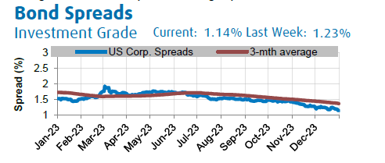
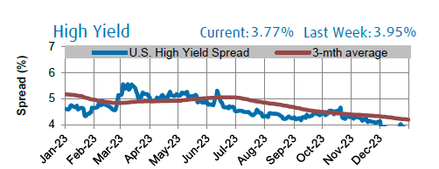
Credit Spreads
January 2024
Spread: In addition to the treasury curve
Corporate Yield = Treasury yield + spread
Higher spread, higher credit risk being priced, >> lower bond prices
Captures the spread between the rates on corporate bonds (either high yield or investment grade) and government bonds. A higher spread could indicate credit concerns. Bloomberg Barclays U.S. High Yield and Investment Grade indices used, respectively.

Slide 28
Credit Rating Process
Business Risks
Industry characteristics
Operational Risks
Management Quality
Financial Risks
Profitability
Capital Structure
Financial Flexibility
Cash flow management
Accounting controls
Asset valuations and volatility

Slide 29
Rating and Default Probability
Ratings are constructed to represent the risk of default; that is, a high (low) rating implies a low (high) probability of default.
Default refers to any event that results in the issuer’s breaching its financial contract. A default could be relatively minor, such as failing to meet a contracted financial ratio like times interest earned (EBIT divided by interest expense). Or a default could be more serious, such as a failure to make an interest or principal payment.
Large companies with strong and stable cash flows are likely to be rated higher than small companies with more volatile cash flows.
Ratings are broken down between short-term and long-term securities, where short term is defined as a maturity of one year or less.
Taken from the HBS case on course site
Notes:
Allen/Patrick

Slide 30
Rating and Default Probability
Notes:
Allen/Patrick

Slide 31
Corporate Bond Portfolio (Credit Portfolio) Risk
Credit risk estimation as weighted expected outcomes
Example
Notes:
Allen/Patrick

Slide 32
Corporate Bond Portfolio (Credit Portfolio) Risk
Joint probabilities
Correlations
Copula functions
State/regime dependent models
Rating changes can become highly correlated at times of macro or sector-wide stress
Can you think of a recent example?
Credit Portfolio
Notes:
Allen/Patrick

Slide 33
Corporate Bond Portfolio (Credit Portfolio) Risk
Credit Portfolio Example
Notes:
Allen/Patrick

Slide 34
Default Prediction
Credit Rating organizations (S&P, Moody’s, Fitch etc.) constantly estimate and recalibrate statistical models with new company data and market data. They estimate probability of default, probability of rating change (transition) and recovery ratios.
Rating process incorporates a wide range of information
Specific bond characteristics (term, seniority etc.)
Issuer characteristics
Market conditions
Default prediction is an area where ML algorithms can help improve prediction efficiency and power.

Slide 35
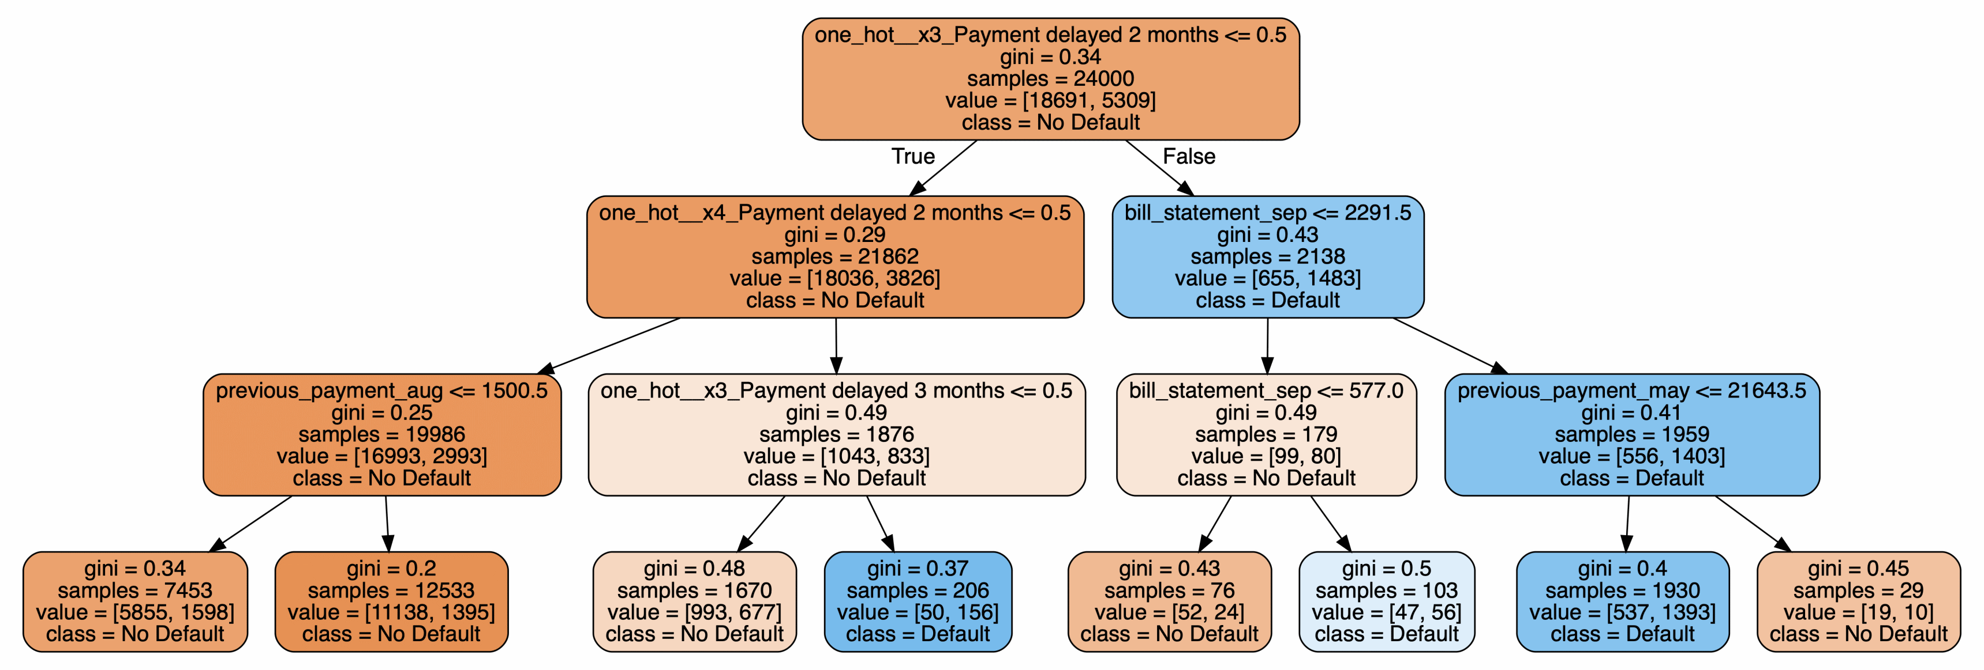
Default Prediction
Simple example of ML decision tree with consumer credit data
https://github.com/robertofranceschi/Default-Credit-Card-Prediction
https://rpubs.com/vtn32/895348
https://www.kaggle.com/code/lucabasa/credit-card-default-a-very-pedagogical-notebook
Python-for-Finance-Cookbook/Chapter 08 at master · PacktPublishing/Python-for-Finance-Cookbook · GitHub

Slide 36
Next Session
FX Markets
Derivatives and Options: Pricing, Hedging, Speculation
Cases to Read:
Overview of Credit Ratings
Yield Curve and Growth Forecasts
Hedge Funds

